Slide 1


Advanced Excel functions (INDEX, MATCH, INDIRECT)

Slide 2
Excel functions
Advanced functions in excel are powerful tools that can significantly enhance data analysis, manipulation, and reporting. Some of the advanced functions are discussed below.

Slide 3
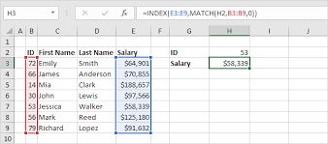
INDEX and MATCH
Syntax =INDEX (Array, row_num, [column_num])
Syntax =MATCH (Lookup_value, lookup_array, [match_type])

Slide 4
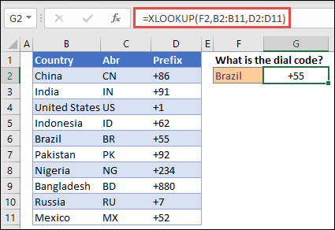
X LOOKUP FUNCTION
A more modern and flexible version of VLOOKUP and HLOOKUP that can look up values both vertically and horizontally and supports exact or approximate matches
Syntax:
X lookup(lookup_value, lookup_array, return_array, [if_not_found], [match_mode], [search_mode])

Slide 5
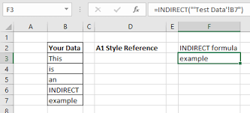
INDIRECT FUNCTION
Converts a text string into a cell reference. This can be used to create dynamic formulas that reference different cells or ranges.[A1])
Syntax:
=Indirect(ref_text, [a1])

Slide 6
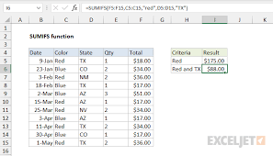
SUMIFS
Syntax:
=SUMIFS(Sum_range, criteria_range1, criteria1, [criteria_range2, criteria2], ...)

Slide 7
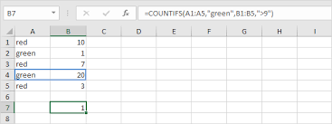
COUNTIFS
Syntax:
=COUNTIFS(Criteria_range1, criteria1, [criteria_range2, criteria2], ...)

Slide 8
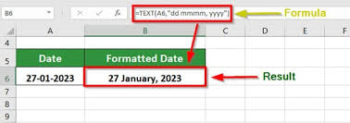
TEXT Function
Converts numbers into text with a specific format (useful for formatting dates, numbers, or time).
=TEXT(Value, format_text)

Slide 9
Conclusion
In conclusion, advanced excel functions offer a powerful suite of tools for data analysis, manipulation, and decision-making. Functions like INDEX and MATCH, XLOOKUP, SUMIFS, and COUNTIF formulas allow users to handle complex datasets with precision and flexibility.Mastering these advanced functions not only improves efficiency but also enhances the accuracy of analysis, making it easier to generate insights, forecast trends, and drive data-driven decisions. As a result, they are invaluable to professionals who seek to optimize their workflows and excel in data-intensive tasks.

Slide 10

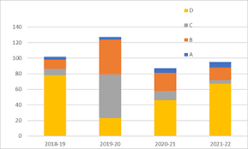

Thank you !!!
ajaycraju98@gmail.com

